Slide 1
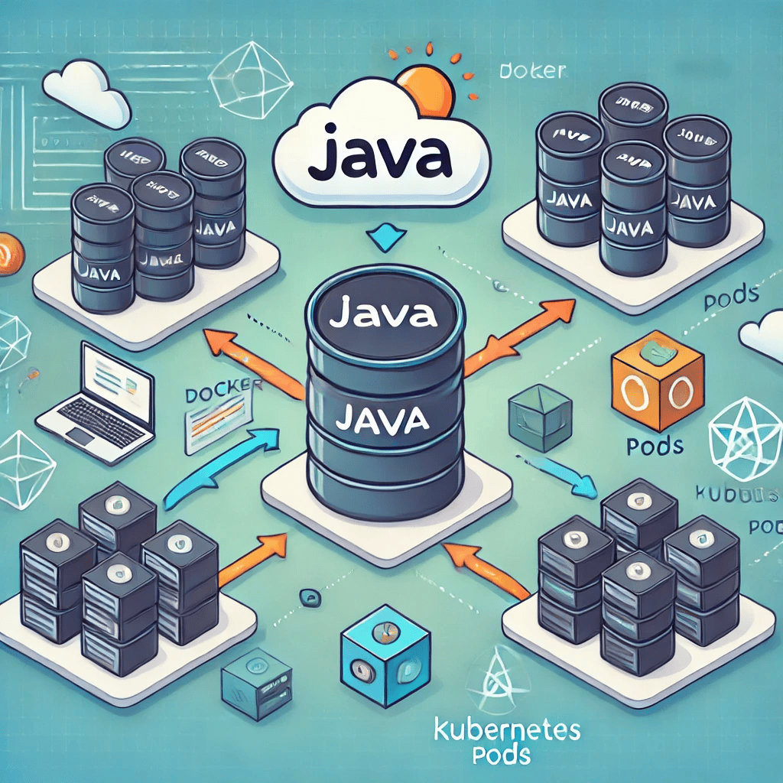

Slide 2

Deploying a Java Application
Agenda
Introduction
Project Overview
Components
Docker & Kubernetes
Deployment Process
Conclusion

Slide 3
Introduction
What is the project? A Java application deployed using Docker and Kubernetes.
Purpose of using Docker and Kubernetes:
Docker: Containerization for consistent runtime environments.
Kubernetes: Orchestration for managing containerized applications at scale.
Key Benefits:
Scalability
Isolation of services
Simplified deployment and management

Slide 4
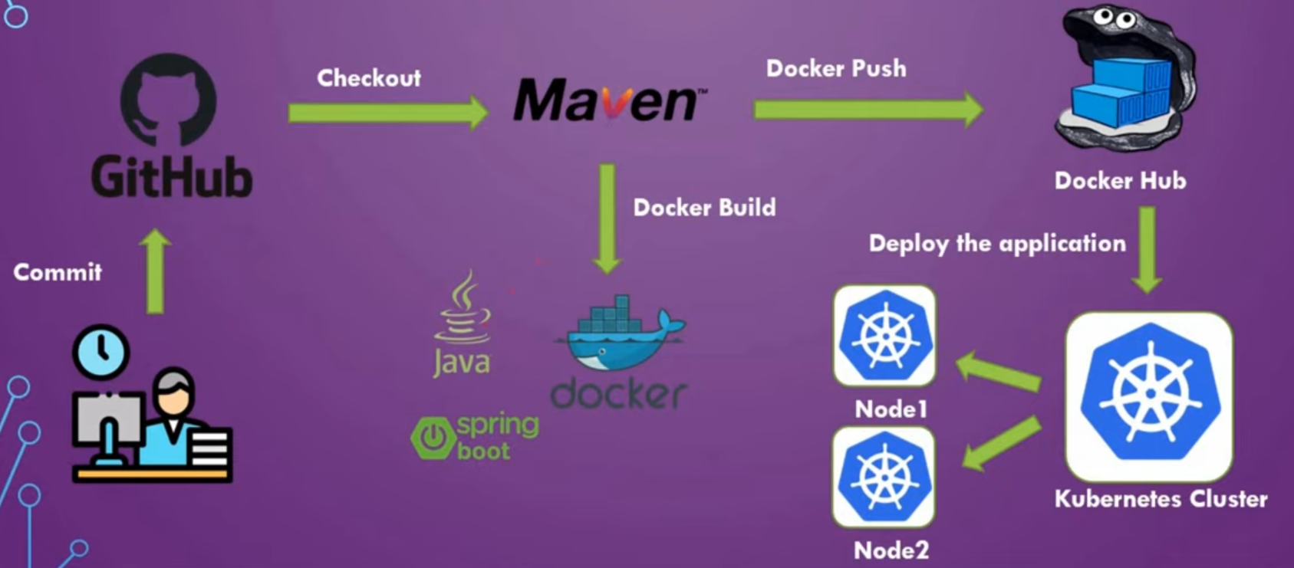
Project Overview

Slide 5
Components
Three main components:
Product Catalogue
Shopfront
Stock Manager
Technologies Used:
Java (Spring Boot)
Docker
Kubernetes

Slide 6
Docker & Kubernetes
Why Docker?
Provides a consistent environment for each service.
Ensures portability between development, testing, and production environments.
Each service has its own Dockerfile
Why Kubernetes?
Automates the deployment, scaling, and management of containerized applications.
Manages pods and services

Slide 7
Deployment Process
Steps in the deployment process:
Development: Java code is developed for each service (Product Catalogue, Shopfront, Stock Manager).
Dockerization: Each service is containerized using Docker.
Kubernetes Deployment: Kubernetes orchestrates the deployment of services as pods.
Scaling: Kubernetes manages scaling and availability through replica sets.

Slide 8
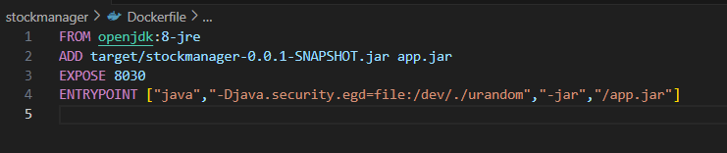
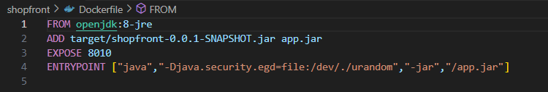
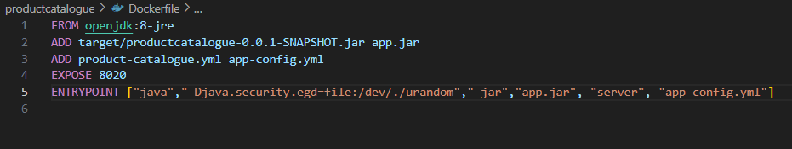

Slide 9
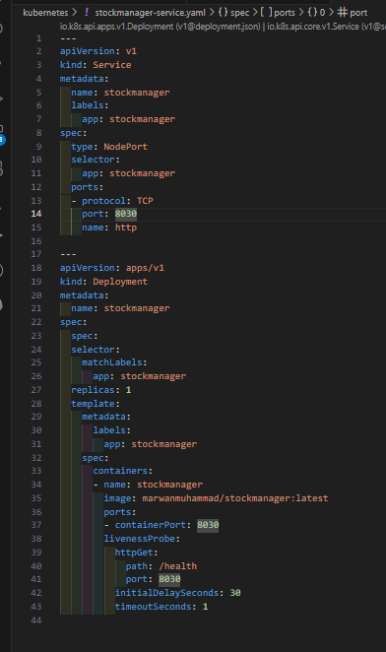
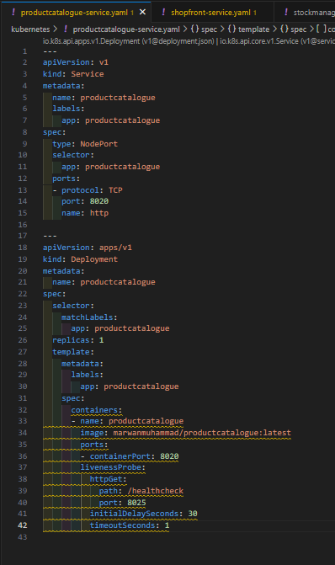
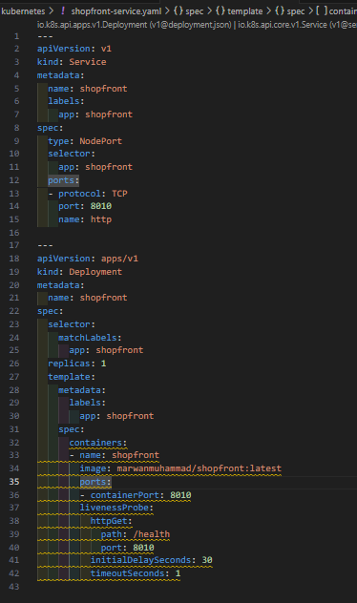

Slide 10
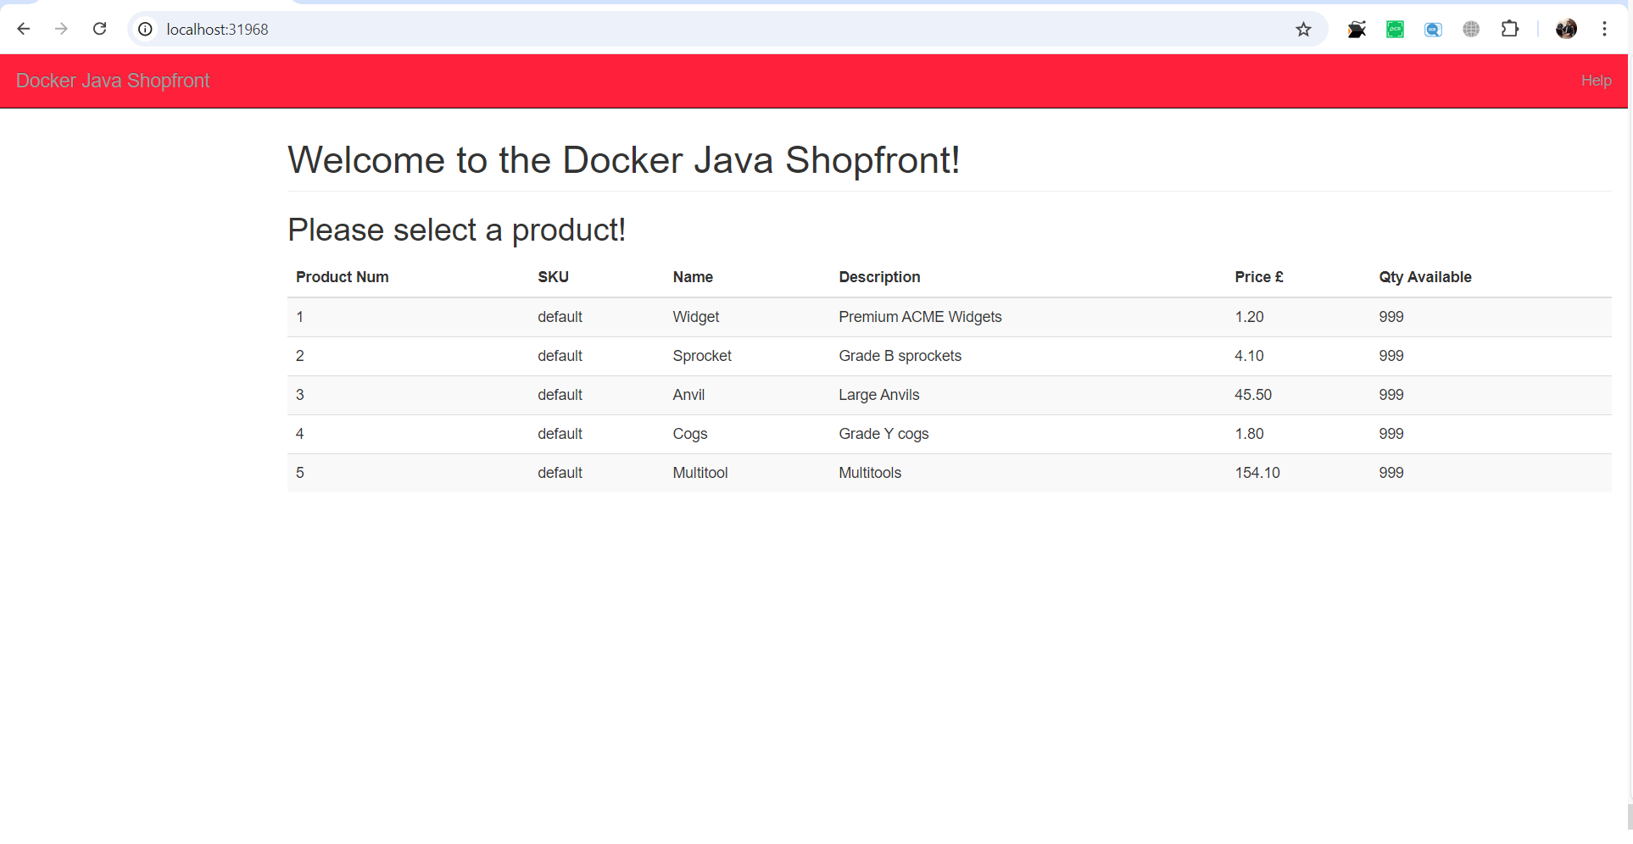

Slide 11
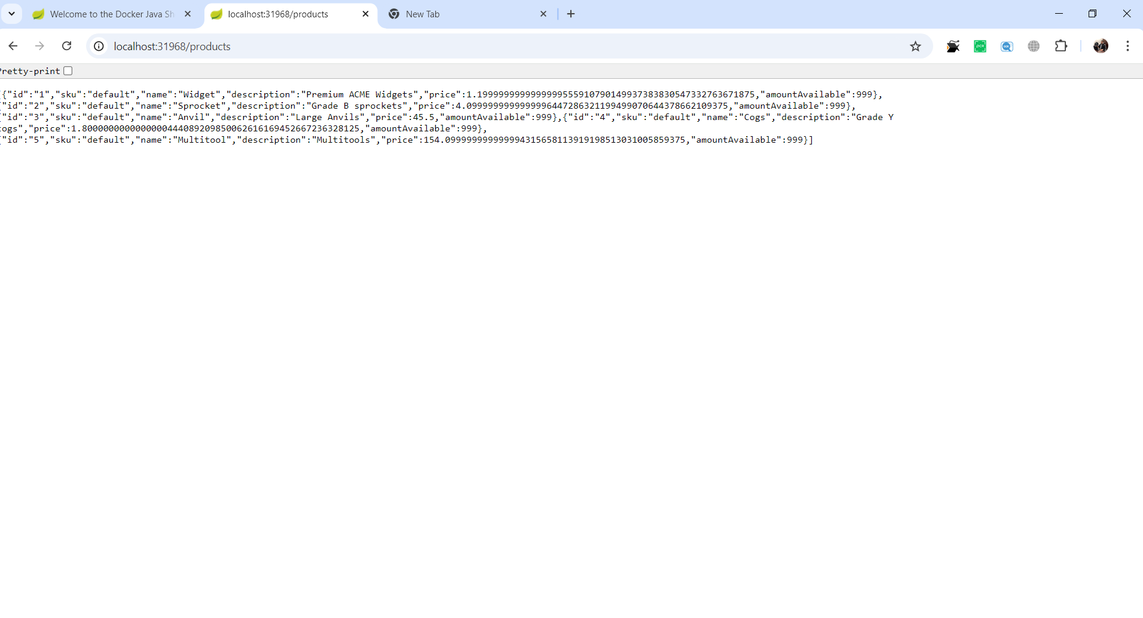

Slide 12
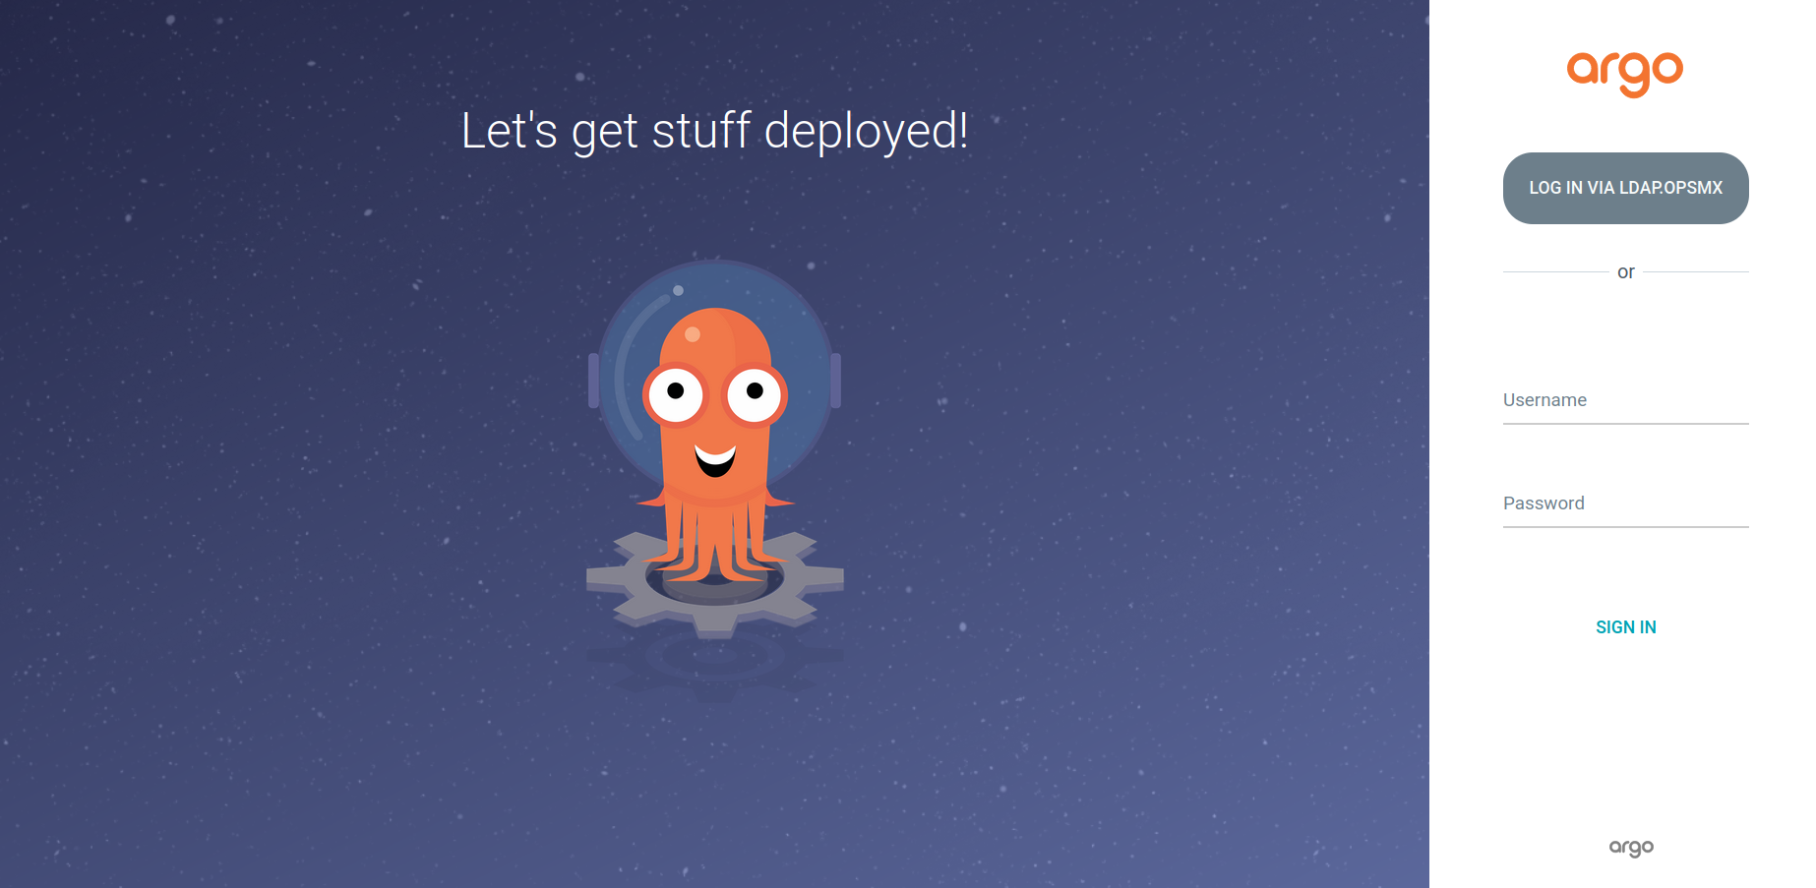

Slide 13
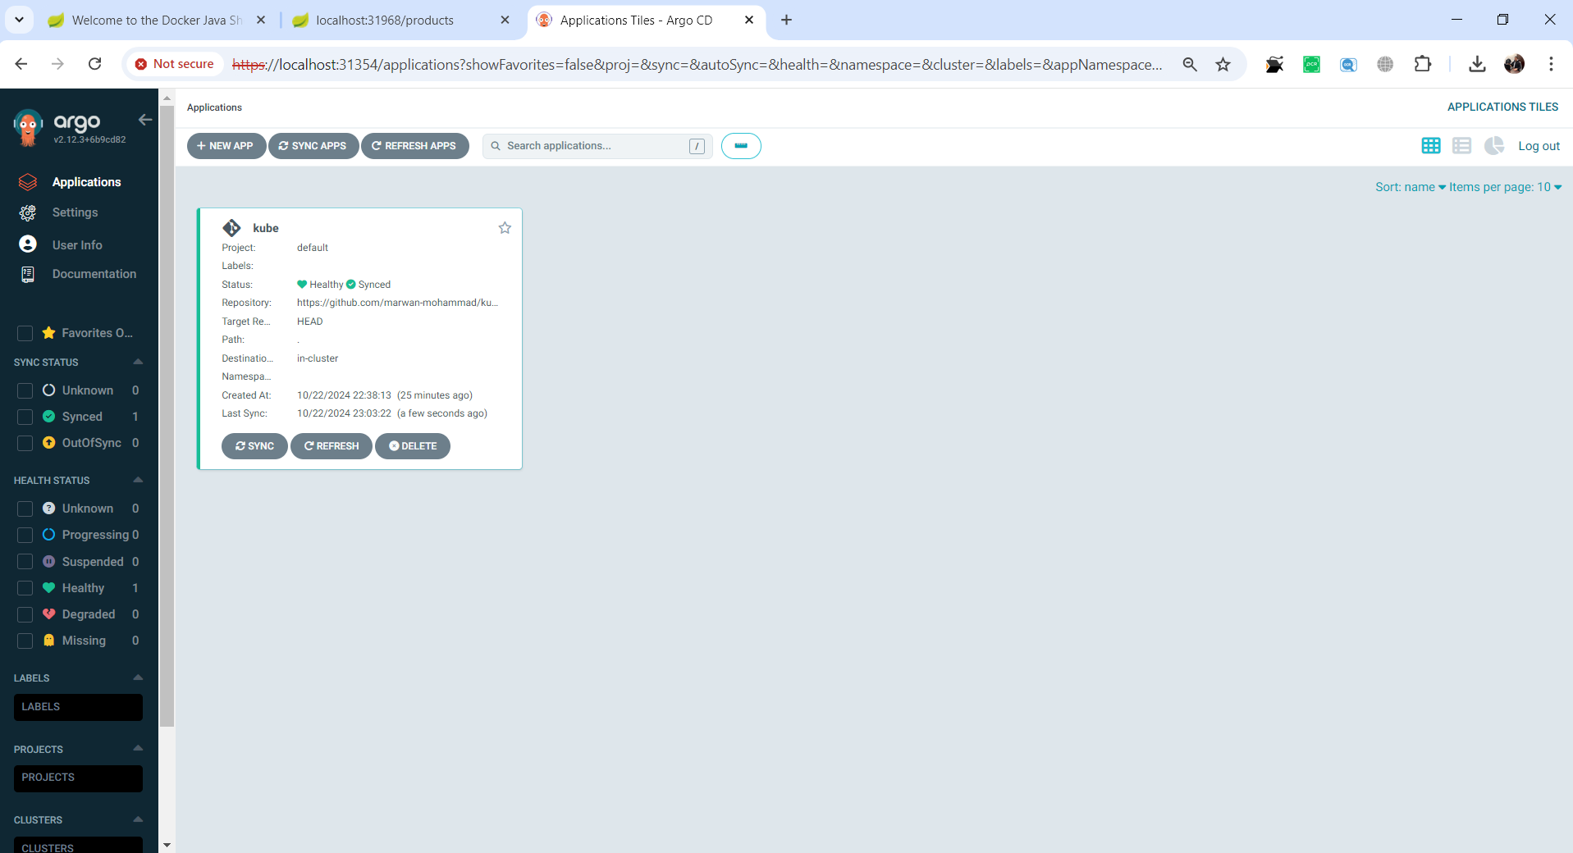

Slide 14
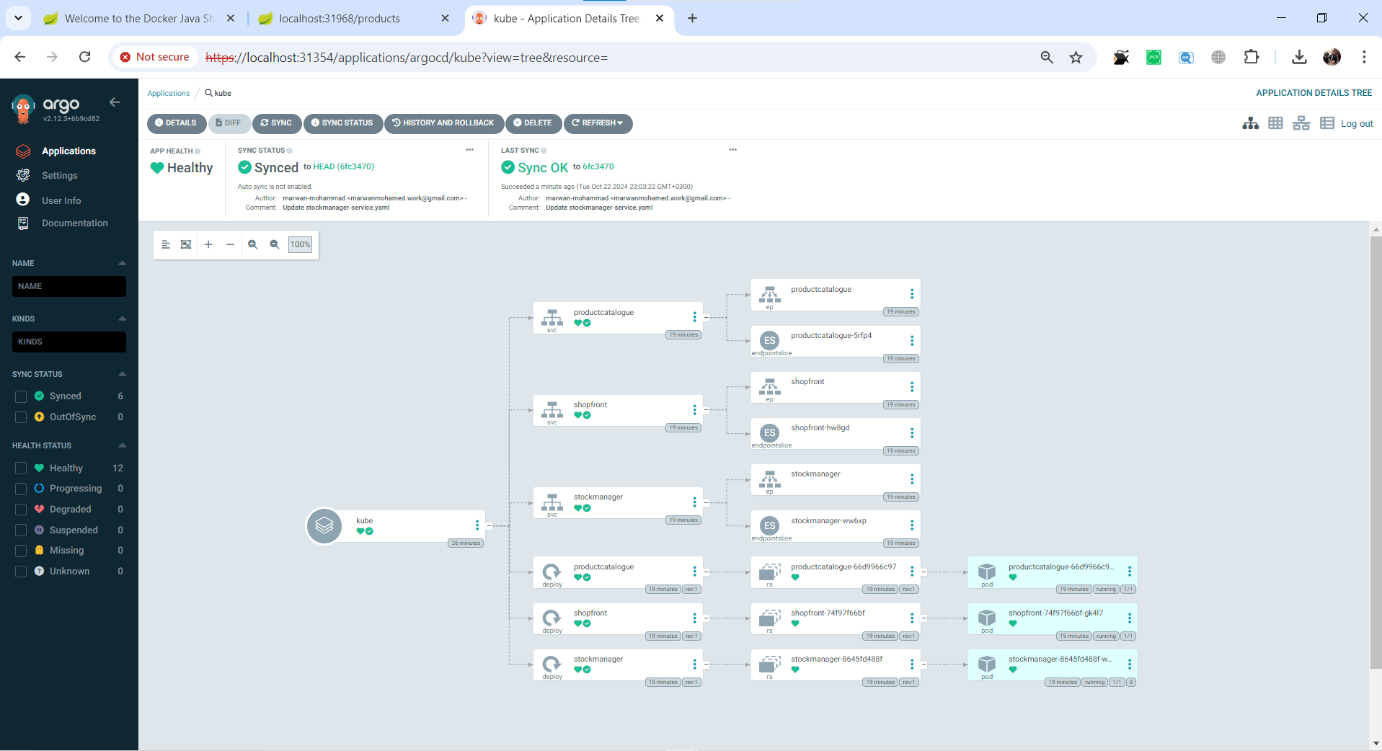

Slide 15
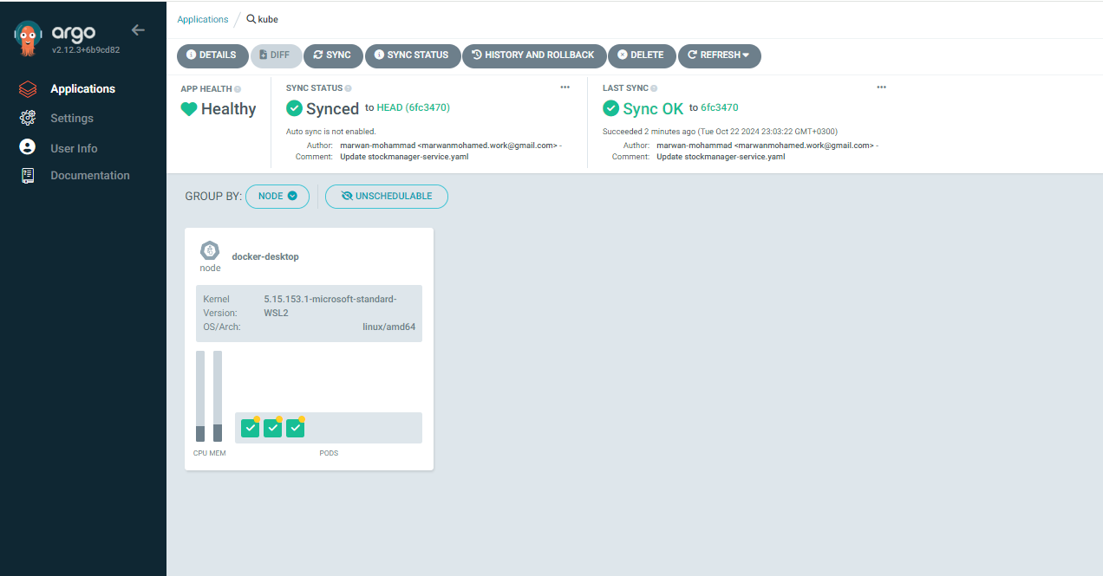

Slide 16
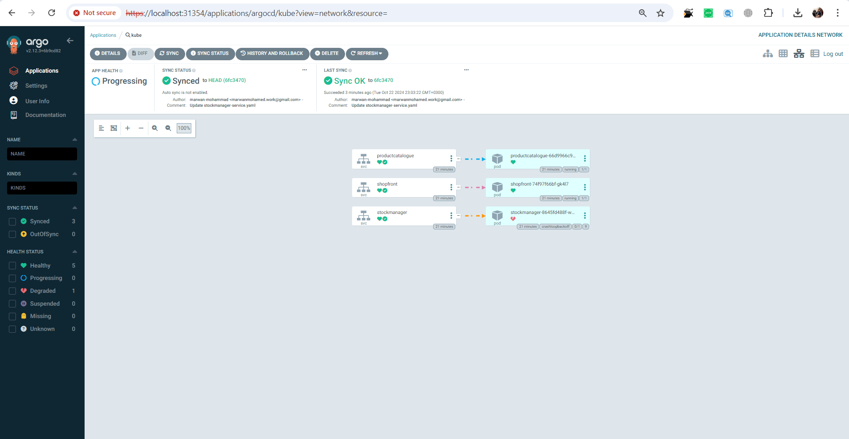

Slide 17
Argo CD
What is Argo CD?
Argo CD is a declarative, GitOps continuous delivery tool for Kubernetes.
It synchronizes Kubernetes manifests in Git repositories with a running Kubernetes cluster.
Ensures that the desired state defined in Git is reflected in the cluster.

Slide 18
Key Features
GitOps-based approach for continuous delivery.
Application definitions, configurations, and environments are versioned in Git.
Automatic and manual sync options.
Real-time application health monitoring.

Slide 19
Argo CD Architecture
Argo CD Core Components:API Server: Exposes a GraphQL/REST API and UI.
Controller: Ensures the state in the Git repository matches the cluster.
Repository Server: Manages Git repository connections

Slide 20
GitOps Workflow
Step 1: Developer pushes changes to Git repository.
1
Step 2: Argo CD monitors the repository for changes.
2
Step 3: When changes are detected, Argo CD automatically applies updates to the Kubernetes cluster.
3
Step 4: Continuous monitoring to ensure the desired state matches the actual state.
4

Slide 21
Benefits of Argo CD
Automated sync between Git and Kubernetes clusters.
Declarative management and versioning of configurations.
Visibility of application status via a user-friendly web UI.
Supports rollbacks and roll-forwards with history tracking.
Scales to manage multiple applications and environments across clusters.

Slide 22
Conclusion
Key Takeaways:
Docker enables consistent environments across development and production.
Kubernetes simplifies the orchestration of microservices and ensures scalability.
The microservices architecture ensures modularity, flexibility, and easier management.

